Slide 1
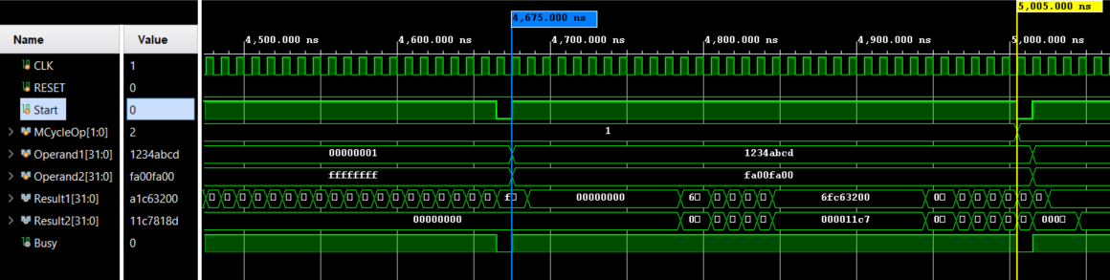
CG3207 Lab 3 – Task 3 Improvements
The Problem:
We were given a multiplier that was inefficient. MCycle checks only the LSB of the multiplier and carry calculates the partial sum every clock cycle. This leads to a scenario where we take about n cycles for n-bit multiplication
32 Cycles to Complete multiplication Operation based on the given sign multiplier

Slide 2
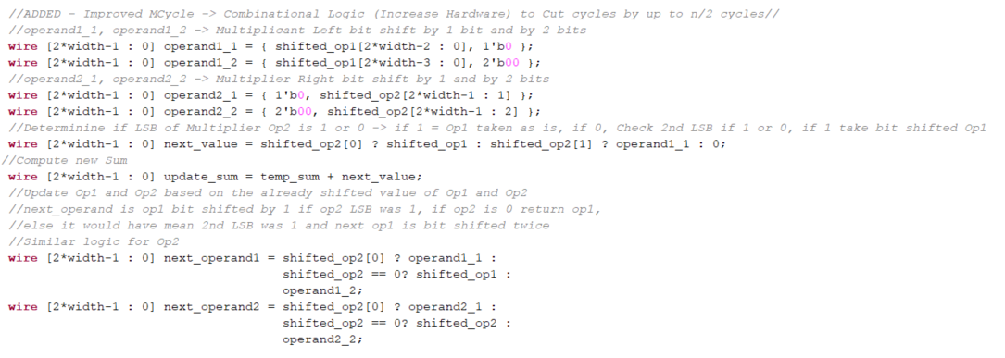
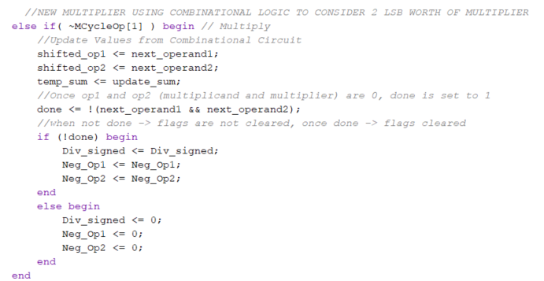
The Solution/Improvement:
Combinational Block:
operand1_1 and operand1_2 are shifted_op1 (multiplicand) left bit shift by 1 and 2 respectively
operand2_1 and operand2_2 are shifted_op2 (multiplier) right bit shift by 1 and 2 respectively
next_value determines next value to be added based on LSB, and the second last LSB of shifted_op2
update_sum determines the latest temp_sum
next_operand1 and next_operand2 determines the next operand1 and operand2 shifted value for next clock cycle
Sequential Block:
Here we update our values and flag every clock cycle
shifted_op1 (Multiplicand) gets updated
shifted_op2 (Multiplier) gets updated
temp_sum (partial products) gets updated
If shifted_op1 and shifted_op2 are 0, done flag will be raised
If not done; Div_signed, Neg_op1, Neg_op2 retains flag status, else done raised; set all flags to 0

Slide 3
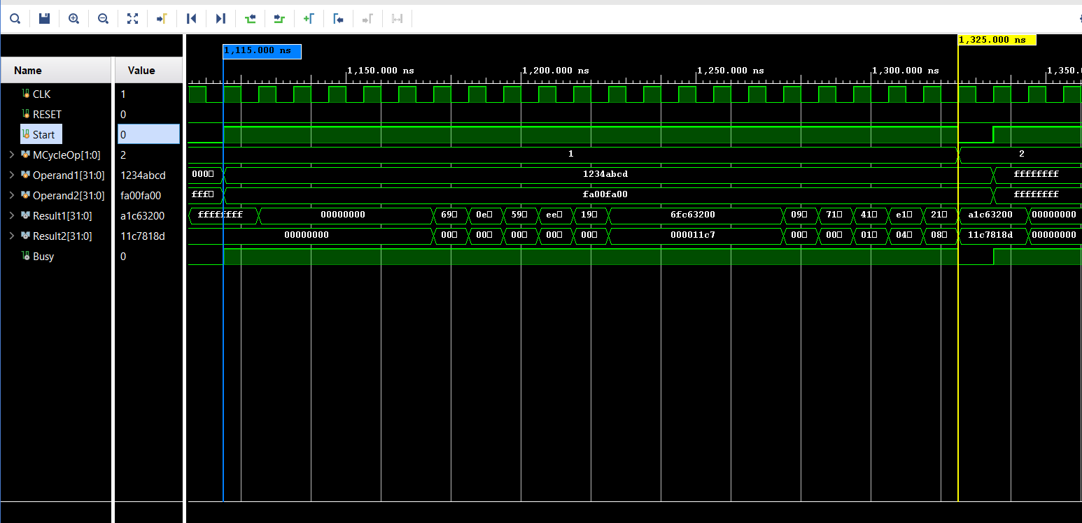
The Outcome:
21 Cycles to Complete multiplication Operation based on the given sign multiplier
Conclusion:
The Improvement is scalable if there is willingness to incur more hardware, as it can scale to check more LSB, currently it looks ahead by 1 bit, so at every cycle it checks Op2[0] and Op2[1], it could scale to Op2[n] (not ideal for sure)
Furthermore, the improvement works well on Multipliers (Op2) that contains more binary 0’s in their number, as this solutions allows us to ‘skip’ as zeroes have generally no effect on the overall multiplication result

